Slide 1


Gala Groceries is a technology-led grocery store chain based in the USA. They rely heavily on new technologies, such as IoT to give them a competitive edge over other grocery stores.
They pride themselves on providing the best quality, fresh produce from locally sourced suppliers. However, this comes with many challenges to consistently deliver on this objective year-round.
Gala Groceries approached Cognizant to help them with a supply chain issue. Groceries are highly perishable items. If you overstock, you are wasting money on excessive storage and waste, but if you understock, then you risk losing customers. They want to know how to better stock the items that they sell.
The client has provided 3 datasets, it is now your job to combine, transform and model these datasets in a suitable way to answer the problem statement that the business has requested.

Slide 2
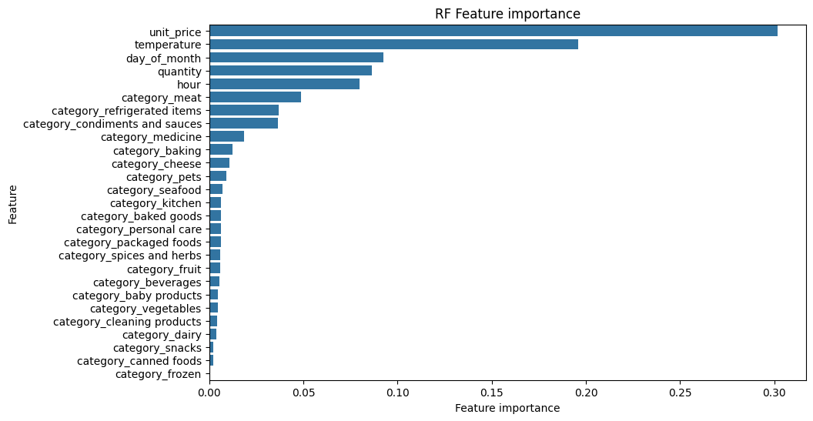
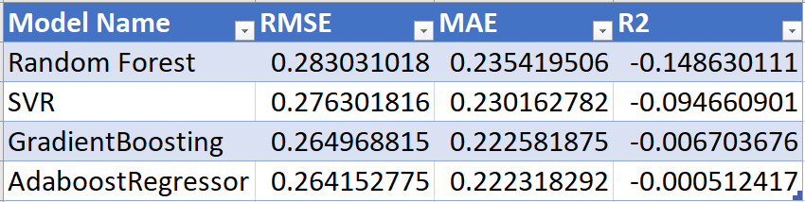
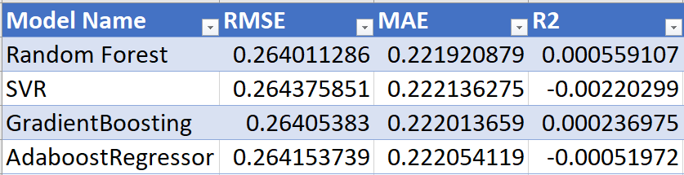
Model Performance:
Default Model
Hyperparameter tuned using RandomSearchCV)
MAE is 0.22 which means that the model outputs the fluctuation of 0.22 from average value (0.51) of estimated stock level pct. This means that on average, the model's predictions are off by 44% of the average estimated stock level.
R2 is very poor, but it has improved from default model output which was more negative.
A larger data set is required to help learn the model in a better way.
Since the given dataset was for only 1 week, more period data will provide insights into trends and patterns.
From important feature list we can see that unit_price, temperature, quantity,hour, play a important role.
We can see that Categories are not so important.
Temperature played a crucial role in the model, and we anticipate that its accuracy will rise when more IOT data are collected over a longer period of time.

